Slide 1


Online food delivery trends
A mini project using Tablaeu
Presented by Manav Shah
Ms in Business Analytics

Slide 2

Project Overview
Objective: The goal of this project is to explore and visualize online food delivery trends using Tableau. This dashboard helps:
Understand customer demographics and preferences
Identify peak order times and popular cities
Analyze payment method usage
Enable data-driven decisions for online food businesses

Slide 3
Why This Data Matters
Reveal customer behavior patterns — knowing when and what people order guides inventory and staffing decisions.
Identify market opportunities — pinpoint underserved cities or demographics for expansion.
Optimize payment processing — focus on preferred payment methods to improve checkout experience.
Improve delivery efficiency — analyzing order times and locations helps reduce delays.
Enhance customer satisfaction — insights into preferences and ratings help tailor marketing and services.

Slide 4
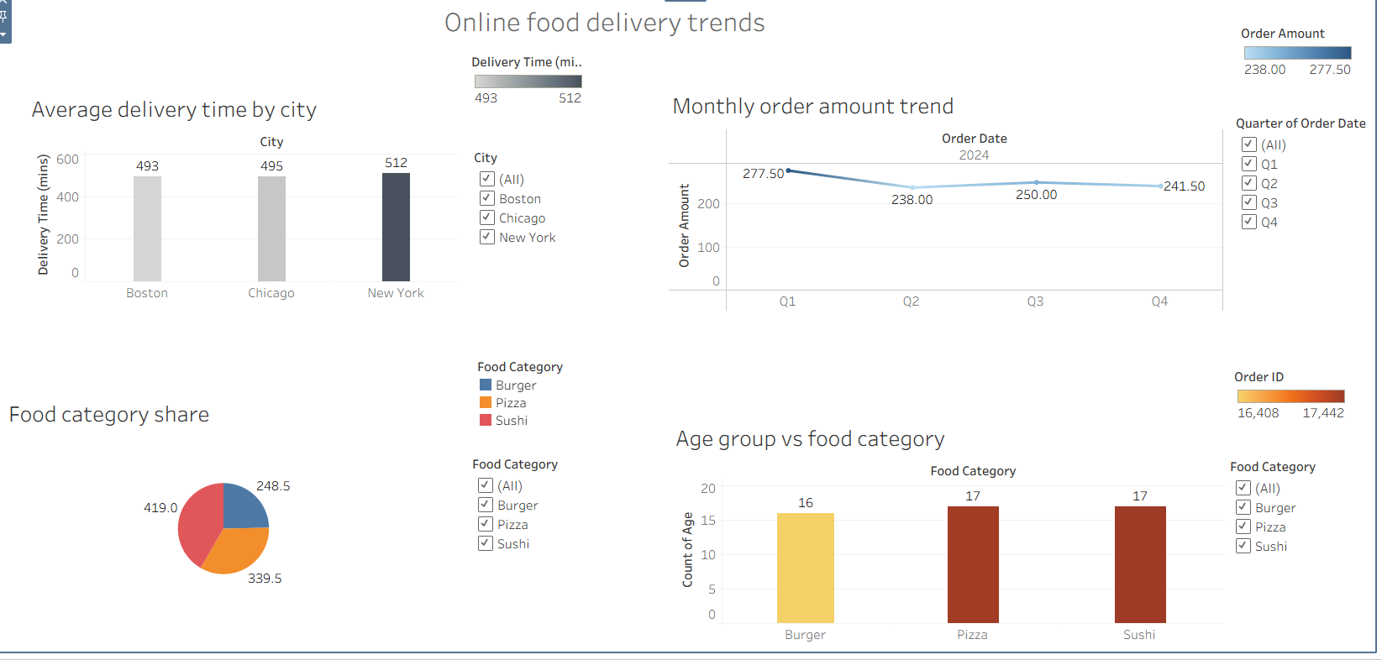
Dashboard Overview
Dashboard Features:
Bar Chart: Top cities by number of orders
Pie Chart: Distribution of payment methods
Heatmap: Hourly & daily order patterns
Filters: Gender, City, and Product for interactivity
Tooltips & Highlights: For better user experience

Slide 5

Key Insights
Findings from Dashboard:
🏙️ Top City: New York (highest number of orders)
🧾 Most Used Payment: Credit Card
🕔 Peak Hours: 12 PM to 2 PM (Lunch Hours)
🧍 Customer Split:
Female: 54%
Male: 46%
🍔 Popular Product: Fast Food

Slide 6
Conclusion
Conclusion:
This dashboard project highlights how Tableau can turn raw data into actionable insights. It can help food delivery businesses to:
Optimize delivery scheduling
Target marketing based on location & gender
Improve customer experience using data
Make strategic business decisions

